Slide 1



IBM DS0101EN
What is Data Science?
4/28/2024
1

Slide 2
Instructor Name
MACHINE LEARNING INTERN, IBM EGYPT
MACHINE LEARNING ENGINEER at ABC
MACHINE LEARNING ENGINEER at ABD
PYTHON AND DATA SCIENCE INSTRUCTOR
4/28/2024
2

Slide 3
In this course, you’ll learn how to:
Define data science and its importance in today’s data-driven world.
Describe the various paths that can lead to a career in data science.
Summarize advice given by seasoned data science professionals to data scientists who are just starting out.
Course Modules:
Define data science & What Data Scientists Do
Data science Topics
Applications and Careers in Data Science
Data Literacy for Data Science
4/28/2024
Course Overview
3

Slide 4
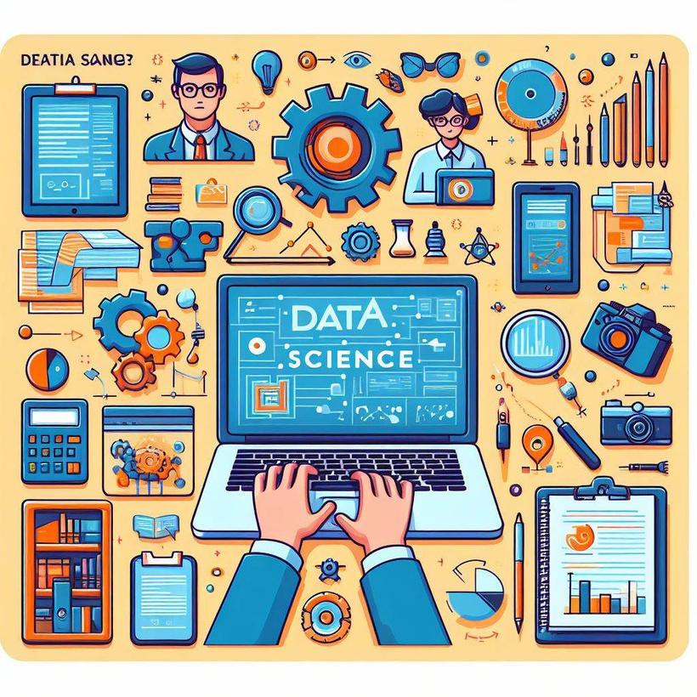
Module I
Define data science & What Data Scientists Do
4/28/2024
4

Slide 5
Module I
Define data science & What Data Scientists Do
What is Data Science?
4/28/2024
5

Slide 6

Understanding Data Science
Data Science is a continuous process of utilizing data to gain insights.
It involves validating hypotheses or models using available data.
The goal is to uncover trends and insights hidden within datasets.
4/28/2024
6

Slide 7

Understanding Data Science
Data is transformed into compelling narratives through storytelling.
These insights drive strategic decision-making for organizations.
It encompasses extracting and analyzing data in structured and unstructured forms.
4/28/2024
7

Slide 8
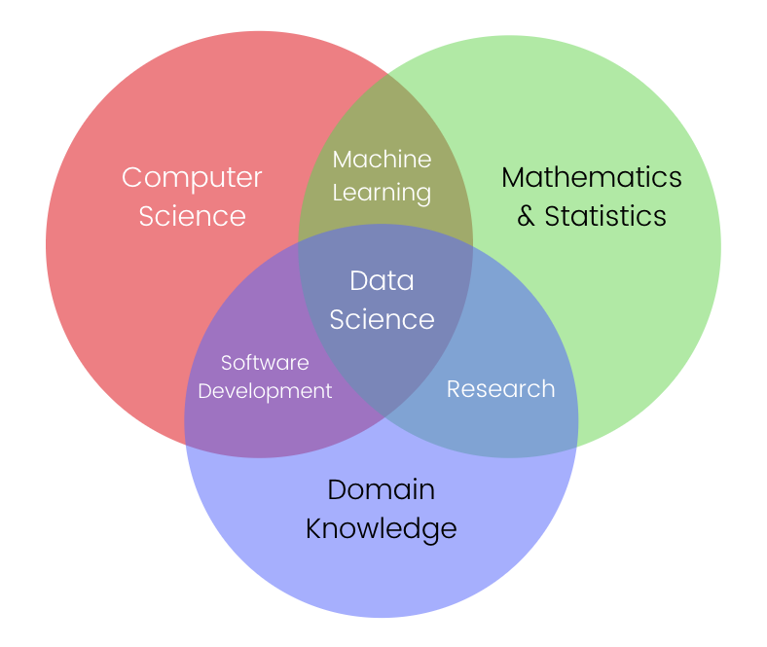
Understanding Data Science
4/28/2024
8

Slide 9

The Essence of Data Science
Data science explores, manipulates, and analyzes data to find answers.
Just as other sciences study specific subjects, data science focuses on understanding data.
Today’s world offers an abundance of data, algorithms, and accessible tools.
The affordability and accessibility of these resources make data science more relevant than ever.
4/28/2024
What is Data Science?
9

Slide 10

The Essence of Data Science
It's a time of unprecedented opportunity for those interested in data science.
Data science thrives on curiosity, exploration, and leveraging available resources.
4/28/2024

Slide 11
Module I
Define data science & What Data Scientists Do
Fundamentals of Data Science
4/28/2024
11

Slide 12

Understanding Data Science
Data Science encompasses significant data analysis across various sources.
It leverages vast quantities of data from diverse sources like social media and sales.
Advancements in computing power enable meaningful analysis and new discoveries.
4/28/2024
12

Slide 13

Understanding Data Science
Data science aids organizations in understanding their environments and uncovering opportunities.
Data scientists investigate data to add value and insight to the organization's knowledge.
The process starts with clarifying the organization's question or problem.
4/28/2024
Fundamentals of Data Science
13

Slide 14
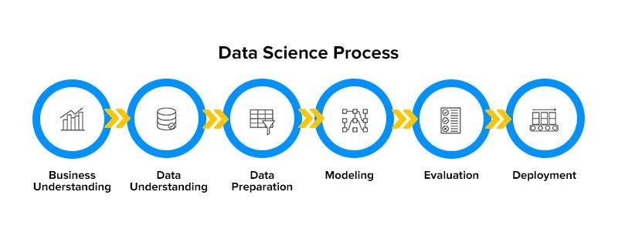
The Data Science Process
4/28/2024
Fundamentals of Data Science
14

Slide 15
Module I
Define data science & What Data Scientists Do
Real-Life Applications of Data Science
4/28/2024
15

Slide 16





REAL-LIFE APPLICATIONS
OF DATA SCIENCE
Let's see some use cases
CHATBOT
VOICE ASSISTANTS
RECOMMENDATION SYSTEM
SELF-DRIVING CARS

Slide 17

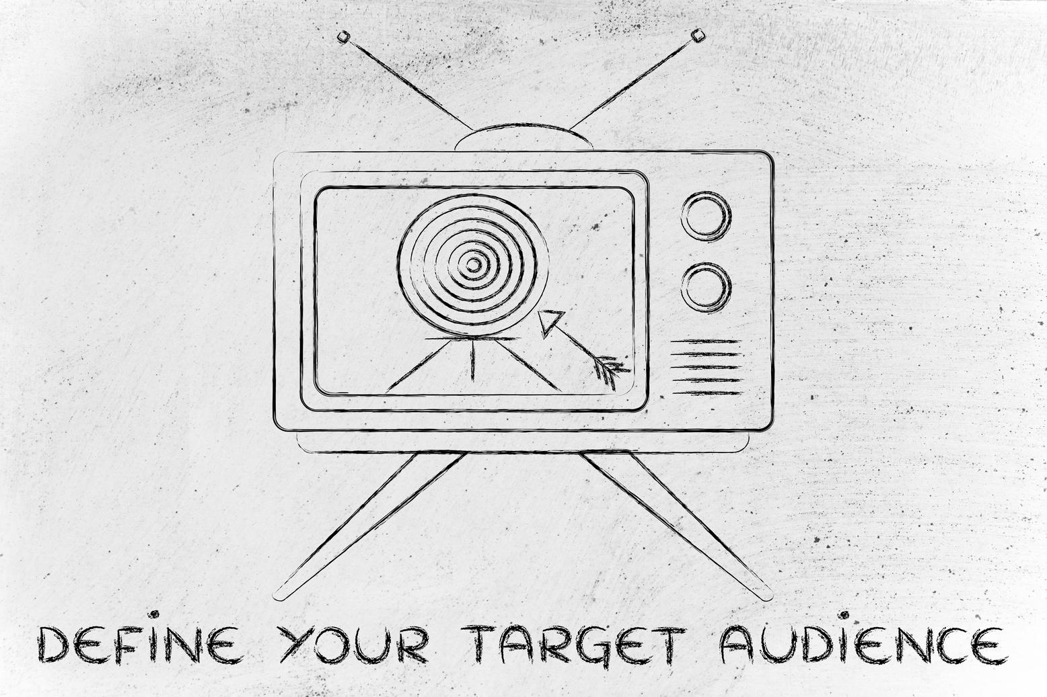


REAL-LIFE APPLICATIONS
OF DATA SCIENCE
Let's see some use cases
CHESS
ADS TARGETING
HEALTH CARE
FRAUD DETECTION

Slide 18
Module I
Define data science & What Data Scientists Do
The Many Paths to Data Science
4/28/2024
18

Slide 19
Evolution of Data Science Careers
Data science was not a recognized field until around 2009-2011.
DJ Patil and Andrew Gelman are credited with coining the term.
Before data science, statistics was a prevalent field.
Individuals often pursued business or other quantitative analysis disciplines.
Exposure to data science often occurred during academic or professional endeavors.
The term "data science" gained prominence in various industries over time.
4/28/2024
The Many Paths to Data Science
19

Slide 20
Personal Journeys into Data Science
Many individuals stumbled into data science through academic or professional paths.
Backgrounds varied from engineering to business, economics, and analytics.
Exposure to data science often occurred during higher education or internships.
Practical applications in fields like transportation engineering introduced individuals to data science.
Gradual immersion in data analysis and modeling paved the way for careers in data science.
The journey into data science showcases diverse paths and backgrounds converging into the field.
4/28/2024
The Many Paths to Data Science
20

Slide 21
Module I
Define data science & What Data Scientists Do
Advice for New Data Scientists
4/28/2024
21

Slide 22
Advice
FOR NEW DATA SCIENTISTS
01
Curiosity
02
Being judgmental
Curiosity is fundamental for exploring and understanding complex data.
Being judgmental helps in forming hypotheses and initial assumptions.
03
Argumentativeness
04
Flexibility
Argumentativeness aids in advocating for a specific direction and learning from data.
Comfort and flexibility with analytics platforms are valuable secondary skills.

Slide 23
Career Development Strategies for Data Scientists
Identify your competitive advantage and preferred industry focus.
Tailor your analytical skills to match the needs of your chosen field.
Acquire proficiency in industry-specific analytics platforms and tools.
Apply your skills to real-world problems to demonstrate your capabilities.
Develop storytelling abilities to effectively communicate insights and findings.
Continuously refine and adapt your skills to stay relevant and competitive in the field.
4/28/2024
Advice for New Data Scientists
23

Slide 24
Module I
Define data science & What Data Scientists Do
Lesson Summary: Defining Data Science
4/28/2024
24

Slide 25
Understanding Data Science
Data science studies data to understand the world around us.
It uncovers insights and trends hidden within vast amounts of data.
Recent advancements in computing power enable deeper analysis and new knowledge.
Data scientists play a crucial role in translating data into actionable insights.
The process involves problem clarification, data collection, analysis, and visualization.
Curiosity, argumentation, and judgment are key traits for successful data scientists.
4/28/2024
Lesson Summary: Defining Data Science
25

Slide 26
Developing Skills and Career Paths
Skilled data scientists possess versatile knowledge beyond statistics and programming.
They come from diverse backgrounds such as economics, engineering, or medicine.
Mastery of data analysis tools and techniques is essential for success.
Specialization in a particular field enhances expertise and industry relevance.
Certification may become necessary as companies prioritize qualified candidates.
Future data scientists will adapt to evolving technology and changing job roles for successful business outcomes.
4/28/2024
Lesson Summary: Defining Data Science
26

Slide 27
Module I
Define data science & What Data Scientists Do
Data Science & Big Data Skills
4/28/2024
27

Slide 28













Data Scientist Skills
Programming Skills
Domain Knowledge
Communication
01
Proficiency in languages like Python, R, or SQL for data manipulation and analysis.
03
Understanding of the specific industry or domain to interpret data in context.
05
Effectively communicating findings and insights to stakeholders through reports and presentations.
Data Analysis
Data Visualization
Problem-Solving
02
04
06
Ability to analyze large datasets using statistical methods and machine learning algorithms.
Creating visual representations of data to communicate insights effectively.
Applying analytical skills to solve complex business problems using data-driven approaches.

Slide 29




Big Data
Volume
Variety
Velocity
Dealing with large volumes of data that traditional systems cannot handle efficiently.
Handling diverse data types such as structured, semi-structured, and unstructured data.
Processing data streams in real-time or near real-time to derive timely insights.

Slide 30



Big Data
Veracity
Value
Tools & Technologies
Ensuring data quality and reliability in a big data environment.
Extracting actionable insights and value from big data for business decisions.
Using platforms like Hadoop, Spark, and cloud services for big data processing and analytics.

Slide 31
Module I
Define data science & What Data Scientists Do
Understanding Different Types of File Formats
4/28/2024
31

Slide 32
Understanding File Formats
Data professionals work with various file types and formats.
Importance of understanding file structure, benefits, and limitations.
Choosing suitable formats for data and performance requirements.
Covered file formats: Delimited text, XLSX, XML, PDF, JSON.
Delimited text files: Rows with values separated by delimiters like commas or tabs.
CSVs and TSVs are common in this category and suited for straightforward information.
4/28/2024
Understanding Different Types of File Formats
32

Slide 33

Overview of File Formats
XLSX:
Microsoft Excel's Open XML format.
Data is organized into worksheets (rows and columns).
Supports formulas, charts, and data manipulation.
Widely used for data analysis and reporting.
XML:
A markup language designed to encode data.
Both human- and machine-readable.
Often used for data exchange between systems and applications.
Flexible and customizable structure for storing and transmitting data.
4/28/2024
Understanding Different Types of File Formats
33

Slide 34
Overview of File Formats
PDF:
Developed by Adobe for consistent document presentation.
Maintains formatting across different devices and platforms.
Ideal for sharing documents where layout, fonts, and images must remain intact.
Commonly used for reports, contracts, and presentations.
4/28/2024
Understanding Different Types of File Formats
34

Slide 35
Overview of File Formats
JSON: Text-based standard for transmitting structured data over the web.
JSON is language-independent, easy to use, and widely compatible.
Understanding popular file formats is crucial for effective data handling and analysis.
4/28/2024
Understanding Different Types of File Formats
35

Slide 36
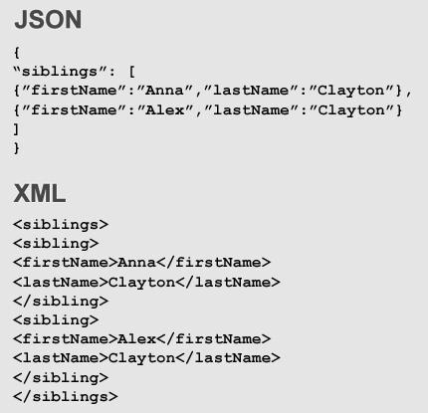
Example of File Formats
4/28/2024
36

Slide 37
Q & A
4/28/2024
Q & A
37

Slide 38
Thank you!
4/28/2024
38

